Slide 1
Preventing Suicide in the Workplace
Presenter Info
Notes:
Insert presenter contact information in text box prior to presentation.
Introduce yourself;
The ‘Know the Signs” Social Marketing Campaign for Suicide Prevention is part of statewide efforts to prevent suicide, reduce stigma and discrimination related to mental illness, and to promote the mental health and wellness of all people in California.
These initiatives are funded by counties through the Mental Health Services Act (Prop 63) and administered by the California Mental Health Services Authority (CalMHSA), an organization of county governments working to improve mental health outcomes for individuals, families, and communities.

Slide 2
Why suicide prevention in the workplace?
Approximately 70% of suicides are among working age adults
In the last 10 years the rate of suicide has increasing most rapidly among adults ages 18-64.
Most adults spend a significant portion of their lives at work.
For many adults, time spent at work is balanced against the need to care for children and aging parents.
Notes:
For a long time suicide rates increased with age, with older adults having the highest rates.
In the last 10 years the rate of suicide among working age adults has been increasing rapidly, more than any other group.
Adults in this age group don’t gather in schools or other settings where they are a captive audience – but most do go to work, whether at a large company or a small mom and pop.
Many are balancing significant family and financial obligations with the many hours each day spent at work, or commuting to and from work.
Employees are usually the largest investment in any business, and a healthy workforce is a productive one.

Slide 3
Good business and the right thing to do
The workplace is can offer a sense of purpose and community, both important protective factors against suicide
The affects of a suicide on other employees can be emotionally devastating
For a business, the financial costs– direct and indirect – can also be devastating
Notes:
Suicide prevention is also good business: As managers and leaders, we want to do the right thing for our business and also for our employees
Employees are the largest and most important investment in any business.
The workplace can foster several protective factors against suicide, including a sense of a sense of satisfaction and purpose as well as a sense of belonging and community for employees that feel supported and part of a team
Studies have shown that for working adults, there is a relationship between job satisfaction and how an employee perceives their work, and depression and suicidal behavior
The affects of a suicide on employees can be emotionally devastating, and costly.…

Slide 4
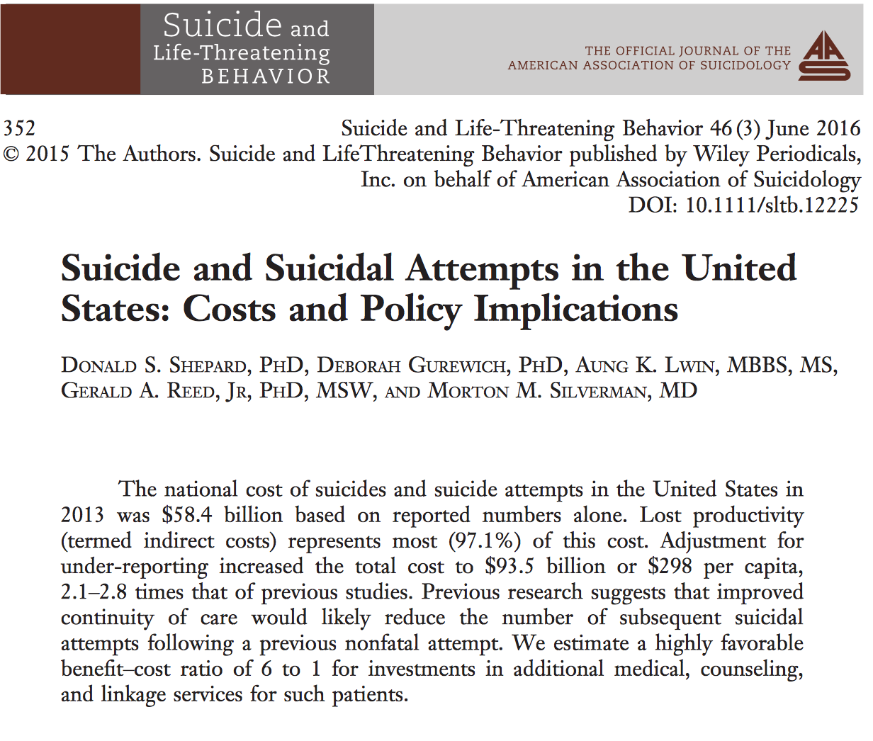
The financial impact
Prevention is a smart, and cost effective investment
Estimated annual costs of suicide deaths and attempts: $93.5 billion
Cost of one suicide: $1,329,553
97% indirect (lost productivity), with the remainder in medical costs
For every $1 spent on interventions and linkages for care, $2.50 is saved in the cost of suicides
Notes:
Suicide also has economic costs, including medical costs for individuals and families, lost income for families, and lost productivity for employers.
The costs of suicidal behaviors—and the savings that can result from preventing these behaviors—can help convince business leaders that suicide prevention is an investment that will save dollars as well as lives.
For example, a recent study revealed the following:
The average cost of one suicide was $1,329,553.
More than 97 percent of this cost was due to lost productivity. The remaining 3 percent were costs associated with medical treatment.
The total cost of suicides and suicide attempts, was $93.5 billion. This estimate accounts for the total known number of suicide deaths and attempts as well as accounting for likely under-reporting of suicidal behavior based on previous studies
Every $1.00 spent on prevention and early intervention saved $2.50 in the cost of suicides.

Slide 5
Comprehensive Blueprint for Suicide Prevention in the Workplace
Where will you
start?
Notes:
The good news is that there are evidence-based and effective strategies for workplace suicide prevention
The Comprehensive Blueprint for Workplace Suicide Prevention is part of a national public-private partnership, the Action Alliance for Suicide Prevention with Working Minds, the Suicide Prevention Resource Center, and the Jed Foundation.
The Blueprint was adapted from the Air Force Suicide Prevention Program, a comprehensive program that demonstrated reductions in suicide, as well as other negative outcomes such as interpersonal violence and substance abuse.
It outlines 8 areas of action that workplaces can take to promote suicide prevention. They include actions that can prevent problems from occurring as well as ways to promote healing and support after a crisis.
Where will our agency/your agency start?

Slide 6
A safe and supportive workplace…
Encourages use of screening tools to identify risk early and connect employees to help.
Offers suicide prevention training for managers, supervisors, and HR staff at minimum.
Promotes behavioral health resources and encourage employees to reach out.
Provides opportunities to educate employees about behavioral health and suicide prevention.
Develops a crisis plan that addresses access to lethal means and support after suicide.
Notes:
What does a safe and supportive workplace look like?
These strategies will require planning and buy-in from leadership down to individual staff.
The investment will pay off in the long run by promoting a workplace that cares about the wellness of staff and encourages employees to reach out when they are concerned about others, or for themselves.

Slide 7
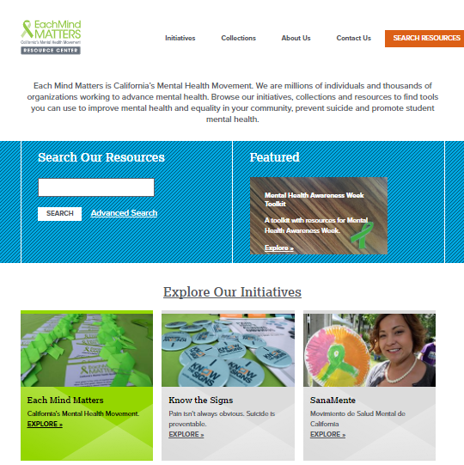
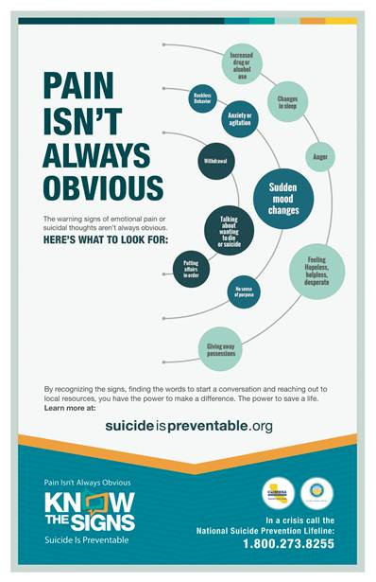
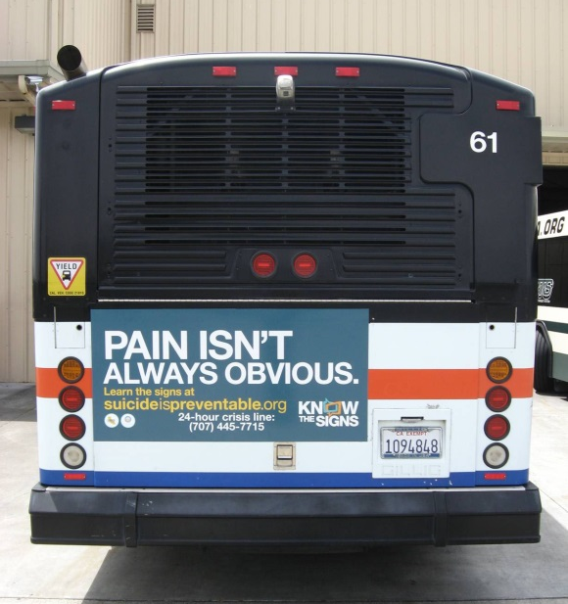
www.EMMresourcecenter.org
Please share!
7
Notes:
More good news: we/you are not alone in this work, and there are many resources to support it.
Know the Signs and other Each Mind Matters materials are available in a variety of languages and cultural perspectives, for free download from the Resource Center at EachMindMatters.org

Slide 8
Resources
The Each Mind Matters (EMM) collection on Resources for Workplace Suicide Prevention: https://www.eachmindmatters.org/change-agents/resources-for-workplace-suicide-prevention/
Comprehensive Blueprint for Workplace Suicide Prevention: http://actionallianceforsuicideprevention.org/comprehensive-blueprint-workplace-suicide-prevention-1
Know the Signs web site: www.SuicideIsPreventable.org
Suicide Prevention training: www.livingworks.net and qprinstitute.com
National Suicide Prevention Lifeline: 1-800-273-8255
Notes:
The Each Mind Matters (EMM) collection on Resources for Workplace Suicide Prevention
https://www.eachmindmatters.org/change-agents/resources-for-workplace-suicide-prevention/

Slide 9
Resources
The Each Mind Matters (EMM) collection on Resources for Workplace Suicide Prevention: https://www.eachmindmatters.org/change-agents/resources-for-workplace-suicide-prevention/
Comprehensive Blueprint for Workplace Suicide Prevention: http://actionallianceforsuicideprevention.org/comprehensive-blueprint-workplace-suicide-prevention-1
Know the Signs web site: www.SuicideIsPreventable.org
Suicide Prevention training: www.livingworks.net and qprinstitute.com
National Suicide Prevention Lifeline: 1-800-273-8255
Notes:
The Each Mind Matters (EMM) collection on Resources for Workplace Suicide Prevention
https://www.eachmindmatters.org/change-agents/resources-for-workplace-suicide-prevention/

Slide 10
Thank You
Presenter Info
10
Notes:
Time for taking questions and comments.

